Slide 1
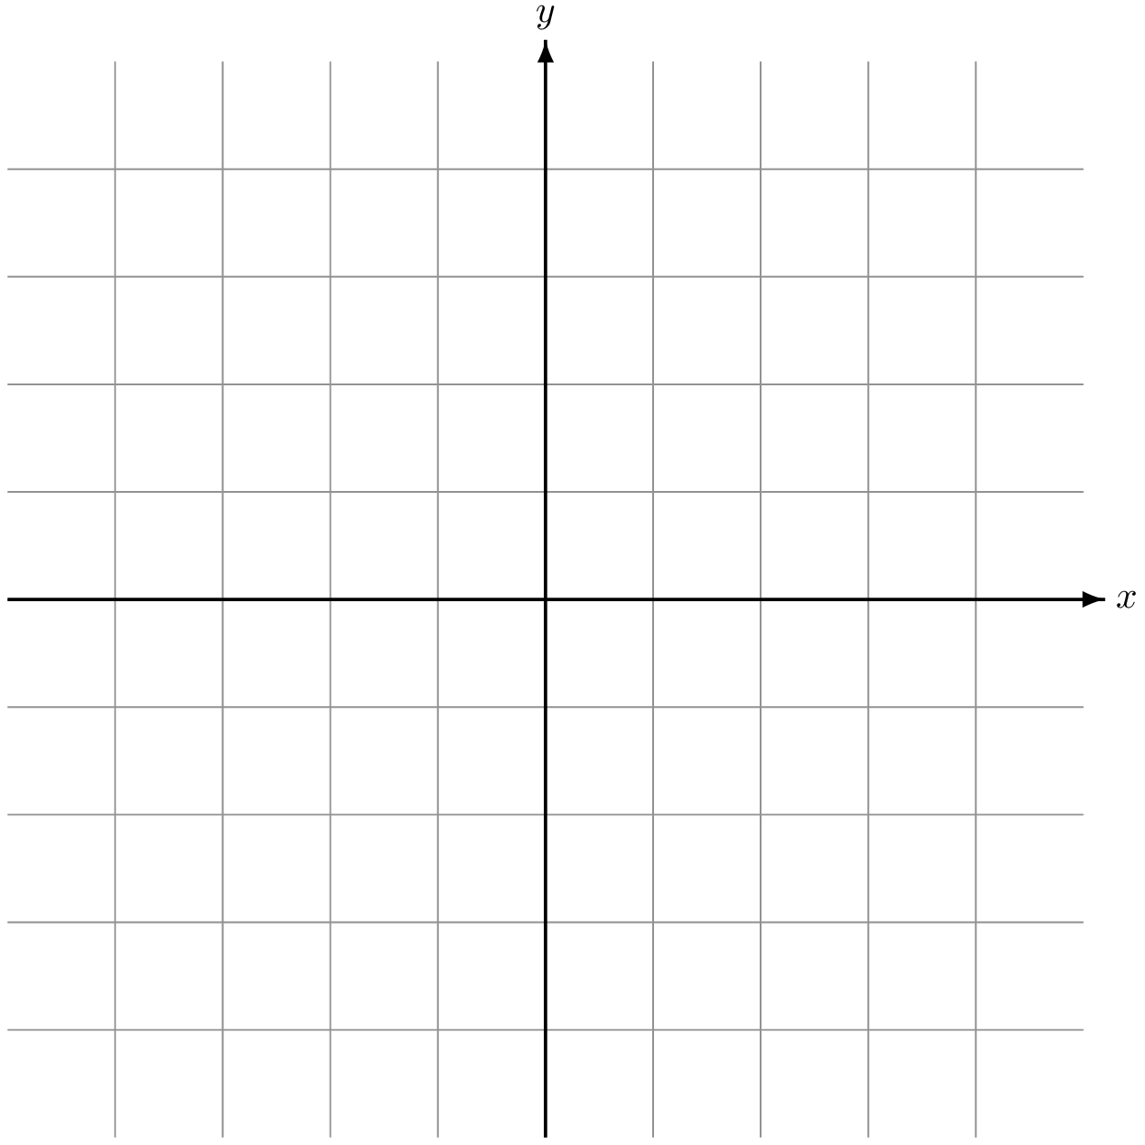
v2
θ
p3
v1
p2
p1
Create two vectors
Normalised and dot product

Slide 2
Racing line data file
Track sections data file
1,{0,0} 2,{0.23,0} ….. ….. X,{x,y}
Track Splicer
Straight,1528,90
Corner,91,242,165 ….
….
Corner,560,600,580
Input
Output

Slide 3
pM
p1
pX

Slide 4
Telemetry data
Coordinator
New Feedback
Main Thread
Telemetry data
Shared Memory
New Telemetry Data
Feedback Module 1
Feedback Module 2
Feedback Module x
Thread 1
Thread 2
Thread x
Thread 1,1
Thread 2,1
Thread x,1
Module 1 Tasks
Module 2 Tasks
Module x Tasks

Slide 5
Telemetry
Discard telemetry
no
Is analysing?
no
Event triggered ?
yes
Is analysing?
no
Start analysis
yes
yes
Stop analysis
Store telemetry
Started braking
Analyse Stopped
Analysing Telemetry
Stopped braking

Slide 6

TeAR
Sim racing game
Telemetry Input Interface
Sections.csv
Supporting Files
Force
Feedback
Controls
Raceline.csv
Telemetry
+
Supporting Structures
Sim Racing Rig
Processing
Telemetry Consumers
Logger
Car Position
Car Handling
Gear Shifting
Feedback
Instructions
Output Interface
Feedback Audio Files
Audio Feedback
Instructions

Slide 7
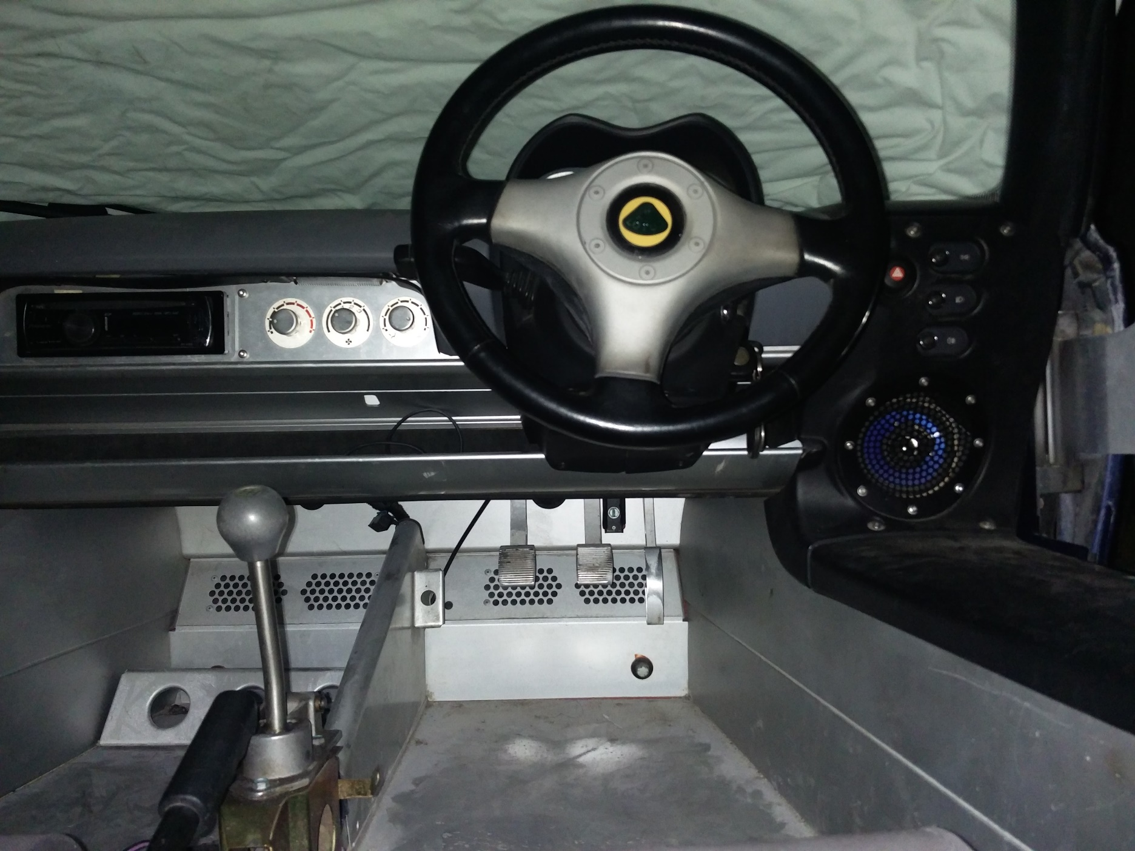
Steering Wheel
H Shifter
Clutch
Brake
Throttle

